Slide 1
Ch-1 Plants Around Us
Science
class-3

Slide 2
Parts Of Plants

Slide 3
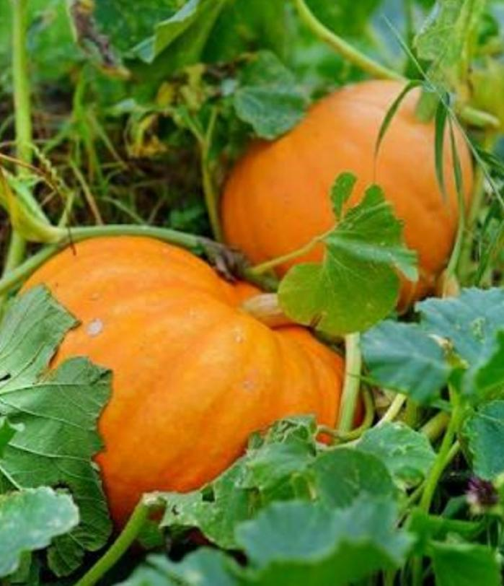
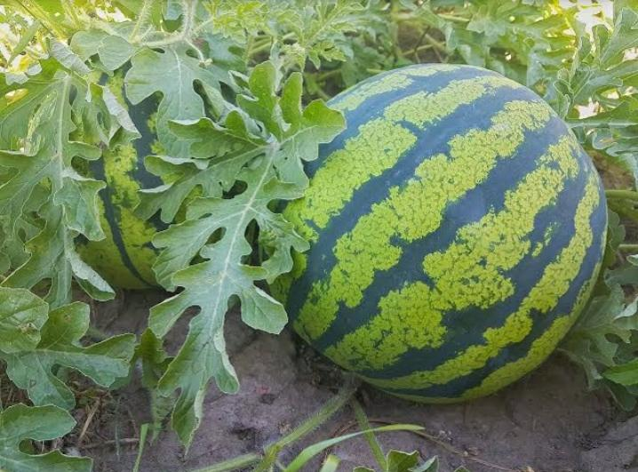
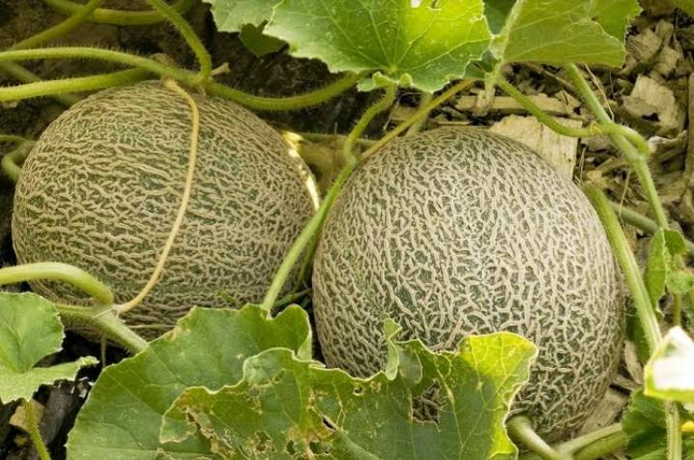
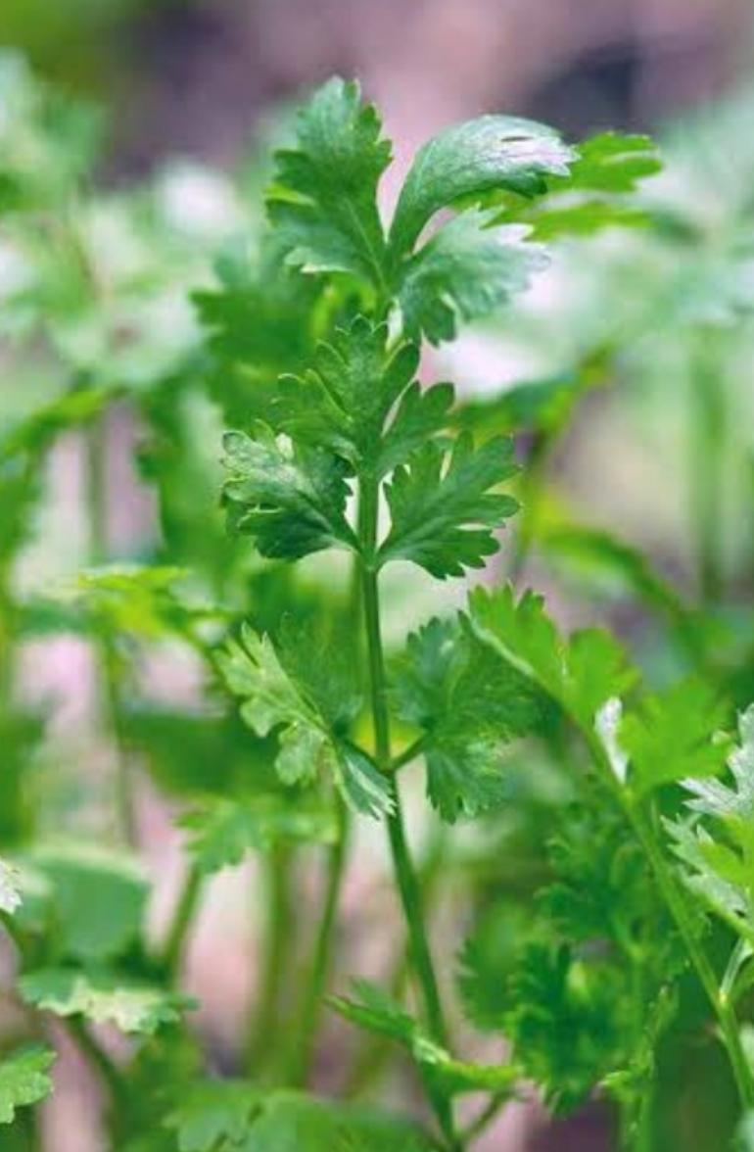
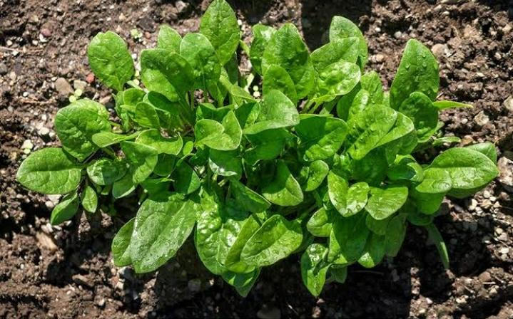
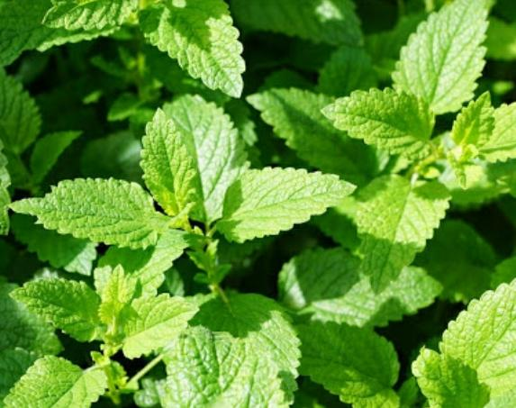
Climbers have weak and soft stem .They need support to stand and grow. Creepers plants have soft green stem. They grow along the ground. Herbs are very smallplants with soft green stem .Their leaves,flowers,seeds are used for flavoring food,cooking, medicine,perfumes,etc.
Types of Plants
Money Plant Pea Plant. Bean Plant
Pumpkin Plant. WaterMelon Muskmelon
Coriander. Spinach Plant. Mint Plant

Slide 4
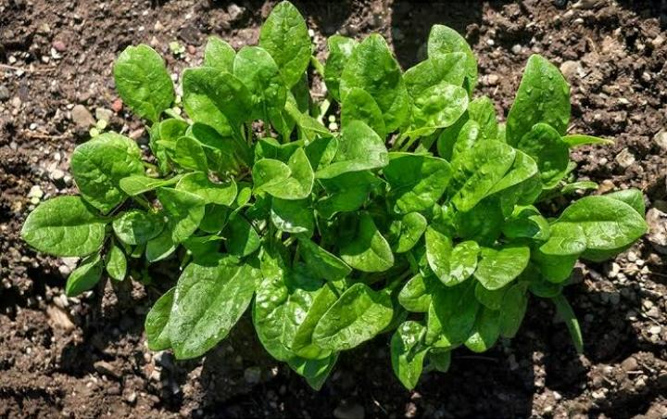
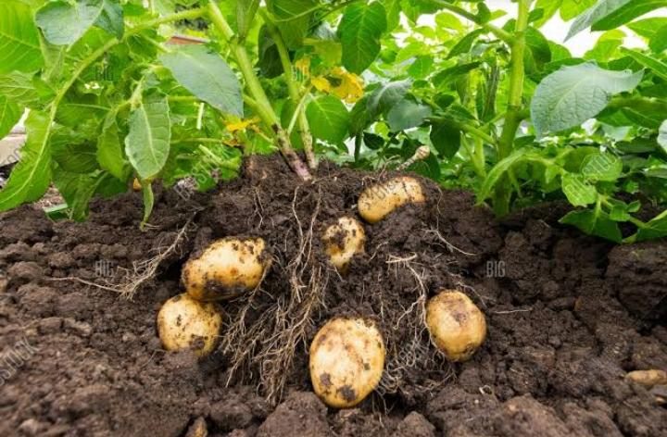
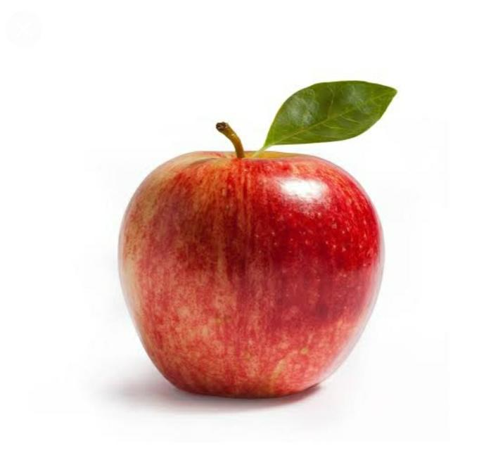
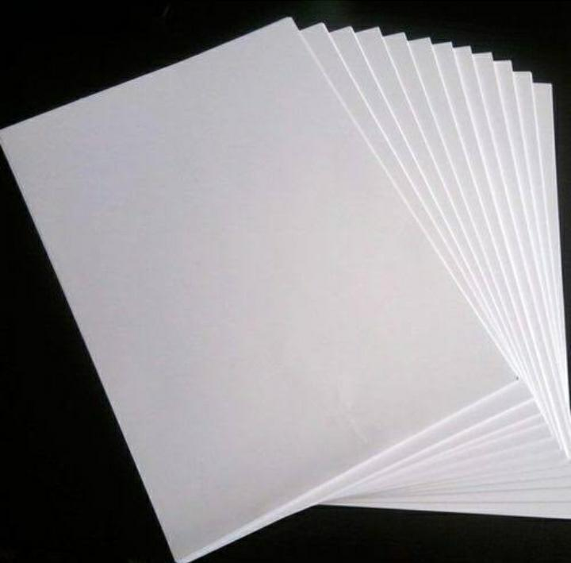
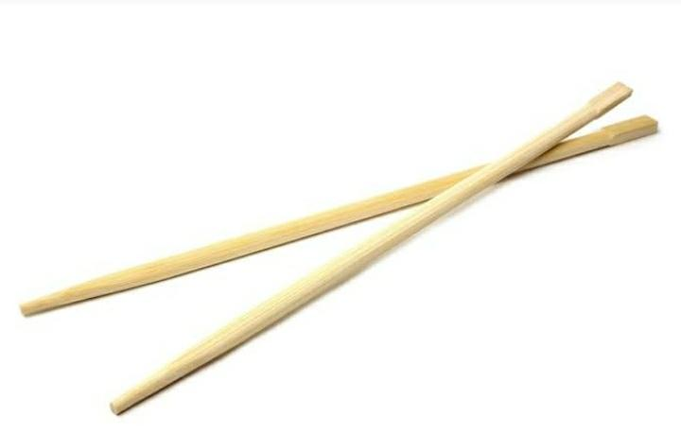
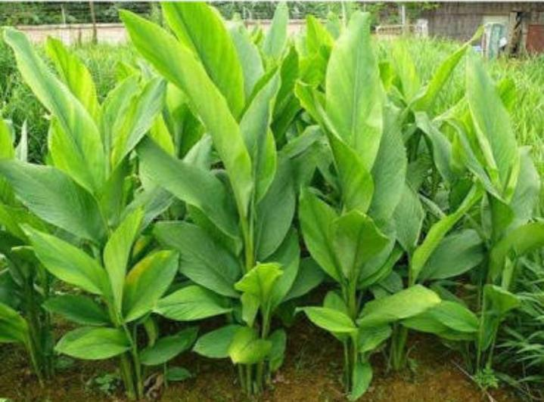
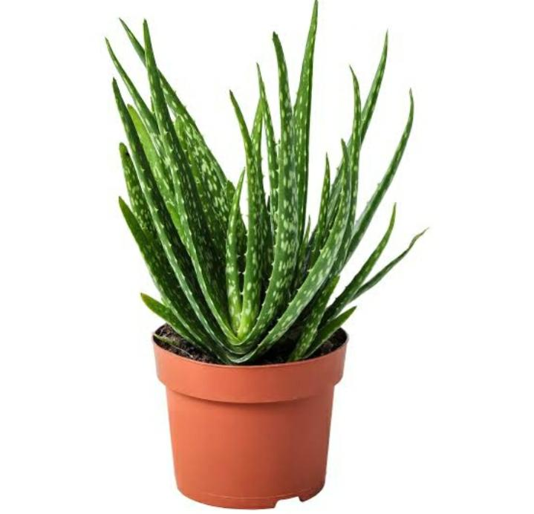
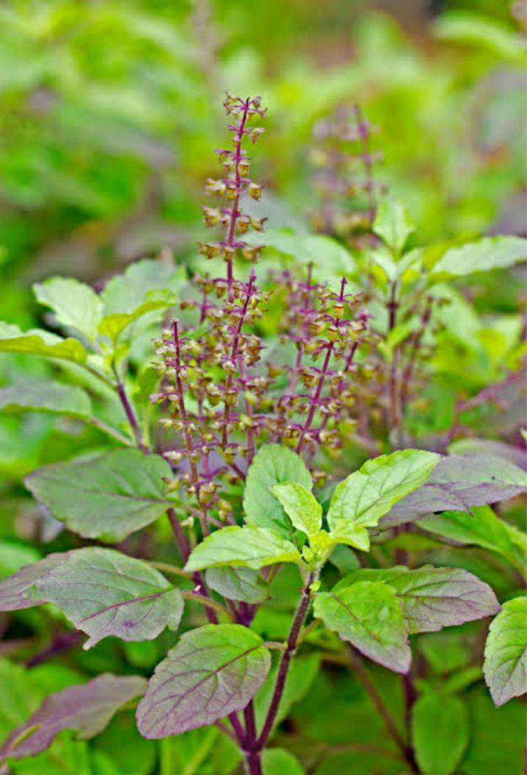
Food
Spinach. Potato Apple
Wood
Paper Chopsticks Wooden Pencil
Medicine
Tulsi Turmeric. Aloe Vera

Slide 5
HomeWork Assignment
Do the following-
Q.1 Draw label and colour parts of plants-
Q.2 Differentiate between creepers and climbers
Q.3 Write down the uses of plants-

Slide 6
Ch-2 Food We Eat
Science
Class 3

Slide 7
All living things need food to grow and live. Food gives us energy. It helps us to stay healthy. We need to eat different kinds of food to stay healthy. We get all the food from. plants and animals.
Food from plants-fruits,vegetables,grains,spices
Food from animals-meat,eggs,milk

Slide 8
Kinds of food
Different kinds of food help us in different ways .Some gives us energy some helps us to grow and some protects us from diseases.

Slide 9
Energy giving food
Some food like potatoes,bread,sugar,butter,oil and sweet gives us a lot of energy.Such foods are called energy giving food.

Slide 10
Body-Building food
The food that help us grow well and make our bone and muscles strong are called body-building food.Some of the body building food are pulses ,beans,eggs,milk,nuts,etc

Slide 11
Protective food
The food that protect us from diseases are called protective food.They help us to remain healthy .These includes fruit and vegetables

Slide 12
Meals &Good food habits
Meals-A meal is a food we eat.We eat three meals in a day -breakfast,lunch and dinner
Some good food habits-
We should wash our hands before and after meals
We should always eat covered food.
We should rise our mouth after eating.
We should chew the food well.
We should never waste food

Slide 13
HomeWork Assignment
Q.1 Draw four nutritious food.
Q.2 What are protective food. Give two example
Q.3 What are body building food . Give two example
Q.4 What are energy giving food. Give two example

