Slide 1
Rational Numbers CHAPTER 1
Class 8

Slide 2
Natural nos- counting starting from 1 i.e. 1,2,3,4,…..
Whole nos- counting nos and zero i.e. 0,1,2,3….
Integers- Integers are a bigger collection of numbers which is formed by whole numbers and their negatives i.e.
…..-3,-2,-1,0,1,2,3……
Rational nos- a number which can be written in the form of p/q, where p and q are integers and q ≠ 0 is called a rational number. For example, 2 ̸ 3,-6 ̸ 7, 2, 0 are all rational numbers.

Slide 3
Properties of Rational Numbers
1. Closure
Addition 0 + 5 = 5, a whole number .Whole numbers are closed under addition.
In general, a + b is a whole number for any two whole numbers a and b.
Subtraction 5 – 7 = – 2, which is not a whole number. Whole numbers are not closed under subtraction.
Multiplication 0 × 3 = 0, a whole number. Whole numbers are closed under multiplication.
In general, if a and b are any two whole numbers, their product ab is a whole number.
Division 5 ÷ 8 =5 ̸ 8, which is not a whole number. Whole numbers are not closed under division.
Similarly natural numbers are closed under addition and multiplication but not under subtraction and division.

Slide 4
Similarly integers are closed under addition, subtraction and multiplication but not under division.
Similarly rational numbers are closed under addition, subtraction and multiplication but not under division.
2. Commutativity
Addition 0 + 7 = 7 + 0 = 7 Addition is commutative.For any two whole numbers a and b,a + b = b + a
For whole nos Subtraction and division is not commutative but Multiplication is commutative.
Similarly natural nos are commutative under addition and multiplication but not commutative under subtraction and division.
Integers are commutative under addition and multiplication but not commutative under subtraction and division.
Rational nos are commutative under addition and multiplication but not commutative under subtraction and division.

Slide 5
3. Associativity
Multiplication 7 × (2 × 5) = (7 × 2) × 5.For any three whole numbers a, b and c
a × (b × c) = (a × b) × c .Multiplication is associative
Whole nos are associative under addition and multiplication but not commutative under subtraction and division.
Natural nos are associative under addition and multiplication but not commutative under subtraction and division.
Integers are associative under addition and multiplication but not commutative under subtraction and division.
Rational nos are associative under addition and multiplication but not commutative under subtraction and division.

Slide 6
Zero is called the additive identity for rational nos, integers and whole numbers.
ex - 2 + 0 = 0 + 2 = 2
1 is the multiplicative identity for rational numbers.
ex - 5 × 1 = 5 = 1 × 5
Negative or additive inverse-
Ex- 2 is the additive inverse of -2 and vice versa. Similarly, -3/5 is the additive inverse of 3/5.
Reciprocal or multiplicative inverse-
ex- 2/3 is the multiplicative inverse of 3/2 and vice versa. Similarly, -5/7 is the multiplicative inverse of 7/-5.
4. Distributivity of multiplication over addition for rational numbers
For all rational numbers a, b and c,
a (b + c) = ab + ac
a (b – c) = ab – ac

Slide 7
Example of Distributive property

Slide 8
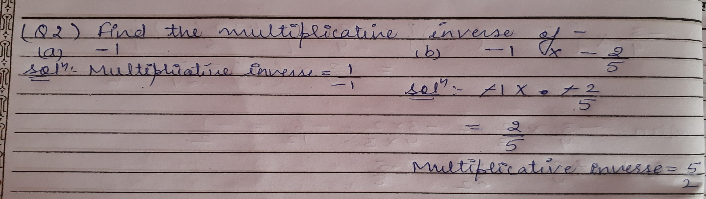
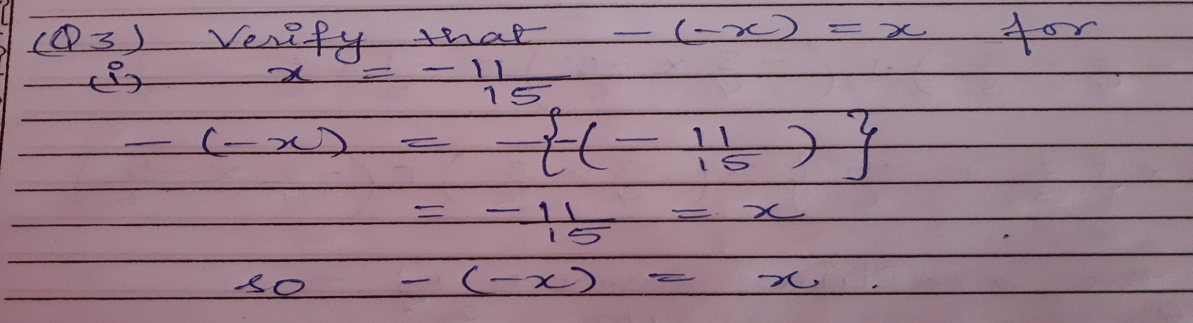

Slide 10
Assignment

